Slide 1
Sociology Course Code (SS 2005)
Muhammad Zeeshan

Slide 2
THEORY AND SOCIOLOGICAL THEORY
A theory is a statement of how and why specific facts are related.
The job of sociological theory is to explain social behavior in the real world.
In building theory, sociologists face two basic questions:-
i) What issues should we study?
ii) How should we connect the facts?
In the process of answering these questions, sociologists look to one or more theoretical approaches as “road maps.

Slide 3
SOCIOLOGICAL PERSPECTIVES
Sociologists make use of three major theoretical approaches:-
Structural-Functional Approach (Macro-level)
Social Conflict Approach (Macro-level)
i) Gender-Conflict approach
ii) Race-Conflict approach
Symbolic-Interaction Approach (Micro-level)

Slide 4
Structural-functional approach
A framework for building theory that sees society as a complex system whose parts work together to promote solidarity and stability.
This approach points to social structure, any relatively stable pattern of social behavior. Social structure gives our lives shape—in families, the workplace, the classroom, and the community.
This approach also looks for a structure’s social functions, the consequences of any social pattern for the operation of society as a whole.
All social structures, from a simple handshake to complex religious rituals, function to keep society going, at least in its present form.
Its major proponents are:-
i) August Comte
ii) Emile Durkheim
iii) Herbert Spencer

Slide 5
Social Functions (Manifest and Latent)
Robert K. Merton (1910–2003) expanded our understanding of the concept of social function by pointing out that any social structure probably has many functions, some more obvious than others.
He distinguished between Manifest functions, “the recognized and intended consequences of any social pattern”, and
Latent functions, the “unrecognized and unintended consequences of any social pattern”.
For example, the manifest function of the U.S. system of higher education is to provide young people with the information and skills they need to perform jobs after graduation. Perhaps just as important, although less often acknowledged, is college’s latent function as a “marriage broker,” bringing together young people of similar social backgrounds.
But Merton also recognized that not all the effects of social structure are good. Thus a Social dysfunction is “any social pattern that may disrupt the operation of society”.

Slide 6
Social-conflict approach
The social-conflict approach is a framework for building theory that sees society as an arena of inequality that generates conflict and change.
Unlike the structural-functional emphasis on solidarity and stability, this approach highlights inequality and change.
Guided by this approach, which includes the gender-conflict and race-conflict approaches, sociologists investigate how factors such as social class, race, ethnicity, gender, sexual orientation, and age are linked to a society’s unequal distribution of money, power, education, and social prestige.
A conflict analysis rejects the idea that social structure promotes the operation of society as a whole, focusing instead on how social patterns benefit some people while hurting others.
Its major proponents are:-
i) Karl Marx
ii) Max Weber
iii) W.E.B DuBois

Slide 7
Gender-conflict approach
One important type of social-conflict analysis is the gender-conflict approach, a point of view that focuses on inequality and conflict between women and men.
The gender-conflict approach is closely linked to feminism, “support of social equality for women and men”.
Its major proponents were:-
i) Jane Addams
ii) Harriet Martineau

Slide 8
Race-conflict approach
Another important type of social-conflict analysis is the race-conflict approach, a point of view that focuses on inequality and conflict between people of different racial and ethnic categories.
Just as men have power over women, white people have numerous social advantages over people of color, including, on average, higher incomes, more schooling, better health, and longer life expectancy.
Its proponents were:-
i) Ida Wells Barnett
ii) W.E.B Du Bois

Slide 9
Macro-level and Micro-level Orientation
The structural-functional and social-conflict approaches share a macro-level orientation, a broad focus on social structures that shape society as a whole.
Macro-level sociology takes in the big picture, rather like observing a city from high above in a helicopter and seeing how highways help people move from place to place or how housing differs from rich to poor neighborhoods.
Sociology also uses a micro-level orientation, a close-up focus on social interaction in specific situations.
Exploring urban life in this way occurs at street level, where you might watch how children invent games on a school playground or how pedestrians respond to homeless people they pass on the street.

Slide 10
Symbolic-interaction approach
The symbolic-interaction approach, then, is a framework for building theory that sees society as the product of the everyday interactions of individuals.
Its main focus is on individuals and groups with importance given to the use of symbols and gestures that people use to communicate with and influence each other.
Its major proponents are:-
i) George Herbert Mead
ii) George Homans
iii) Peter Blau

Slide 11
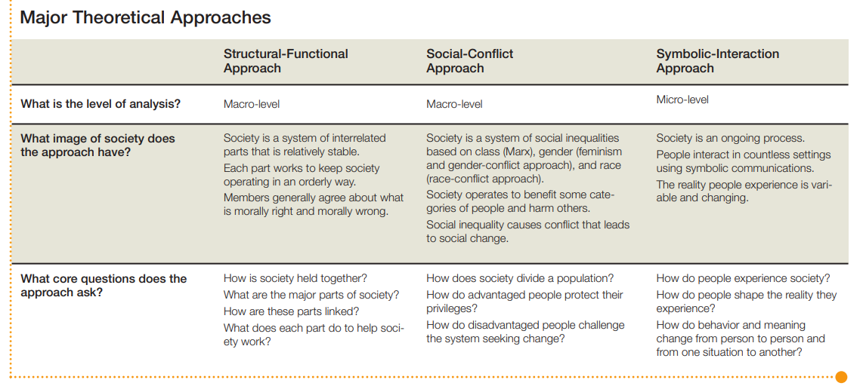

Slide 12
Q&A Session

